Slide 1

Datasets, RDD, Dataframes

Slide 2
What are the RDDs, Dataframes, and Datasets
RDD
Dataframes
Datasets

Slide 3
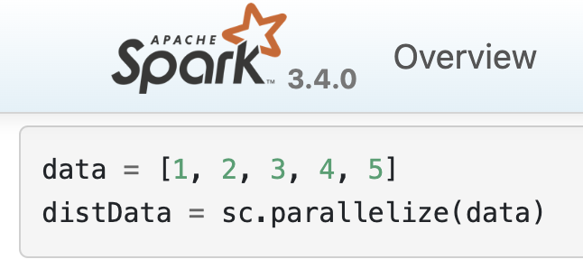
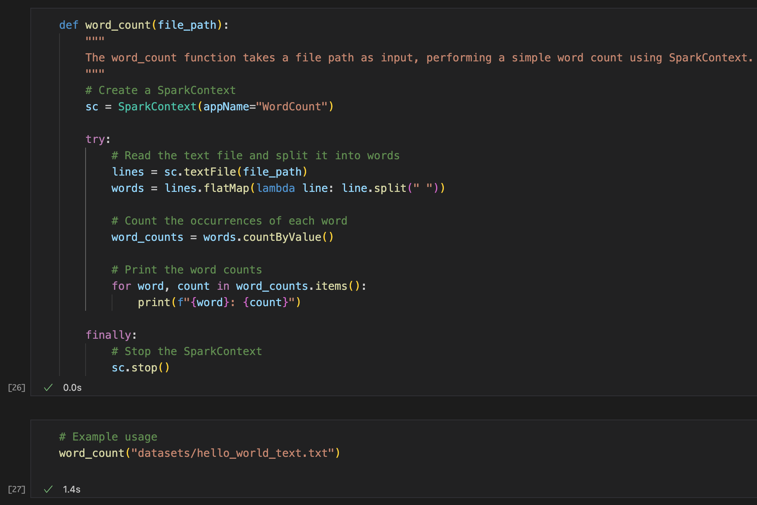
Spark RDD: Resilient Distributed Datasets
RDD = fundamental data structures in Spark
Immutable & distributed data structure.
Fault-tolerant collection of elements that can be operated on in parallel.
Two ways to create RDDs:
Parallelizing an existing collection in your driver program
Referencing a dataset in an external storage system; e.g. HDFS, HBase, Amazon S3, etc.

Slide 4
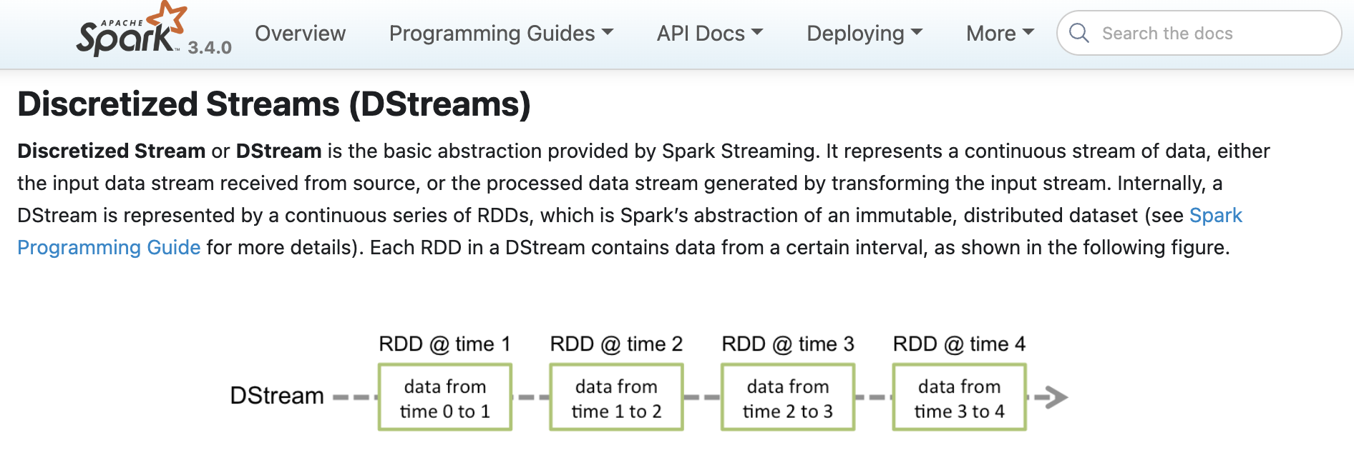
When to use RDD example
RDD are better for Unstructured data.
Example:
Or on our own example!

Slide 5
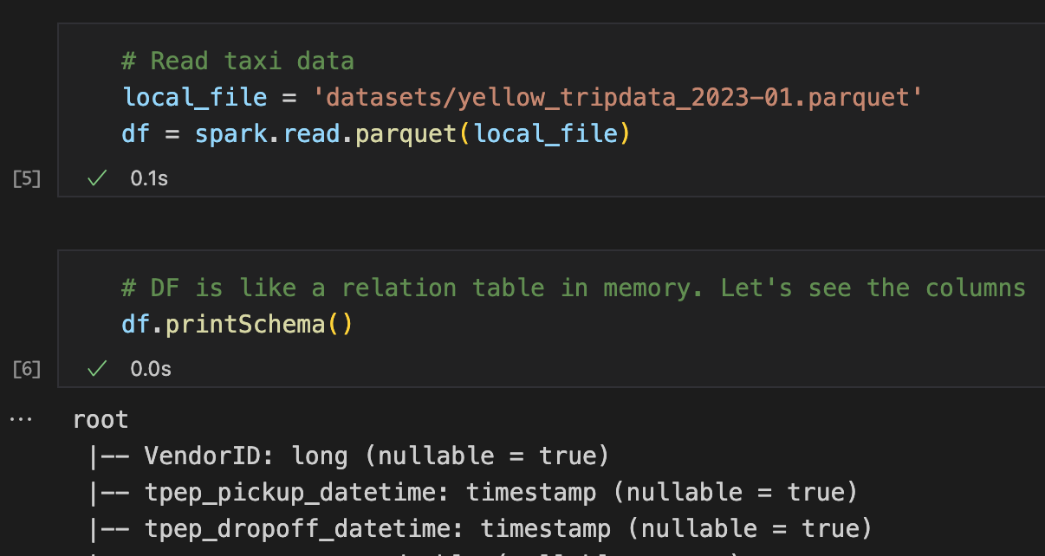
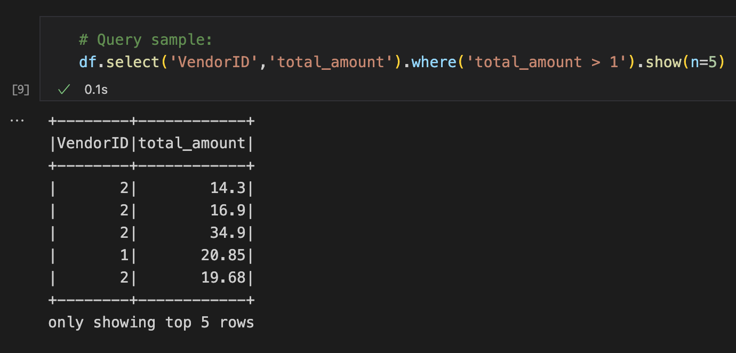
Spark Dataframes
Higher-level abstractions than RDD
Therefore immutable too
Distributed collection of data organized into named columns (schema)
Similar to a table in a relational database.
Simplifies data processing
Excellent for processing semi & structured data, such as CSV, JSON, Parquet, Avro, and more.
Support filters, aggregations, joins, etc!
It uses Sparks Query Optimizer

Slide 6
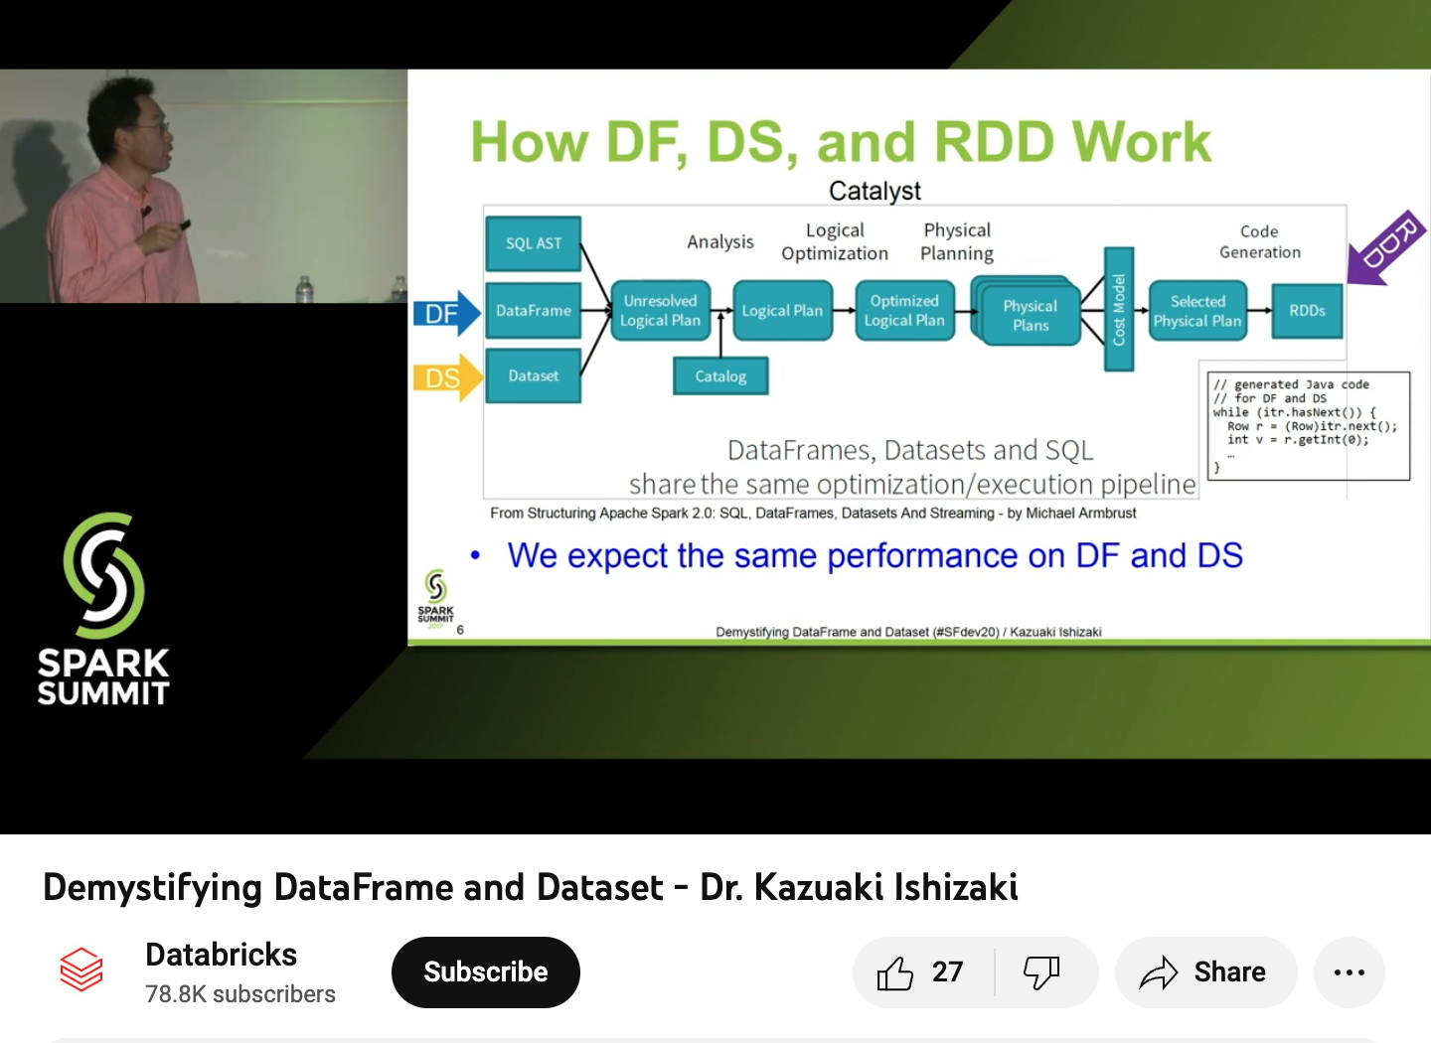
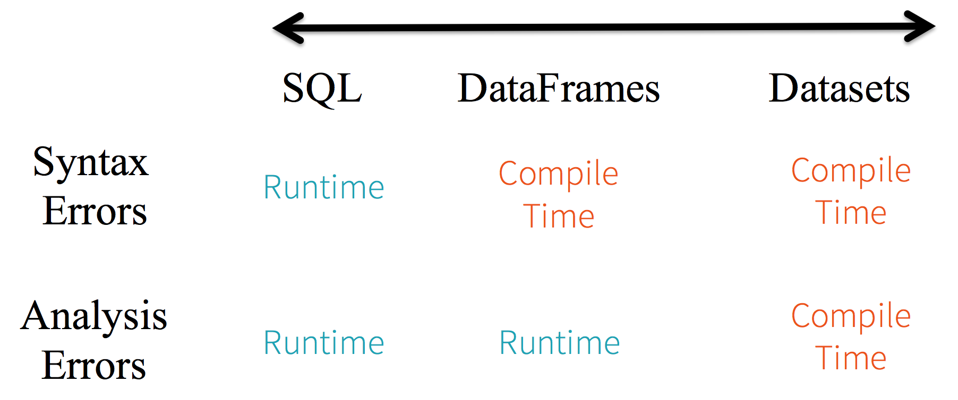
Spark Datasets
Recommended session:
Distributed collection of data
Higher abstraction on top of RDDs and Dataframes
Source: “A Tale of Three Apache Spark APIs: RDDs vs DataFrames and Datasets”, 2016. Databricks, URL https://bit.ly/3WIo64u
Source: https://youtu.be/AIxtaroWqBU

Slide 7
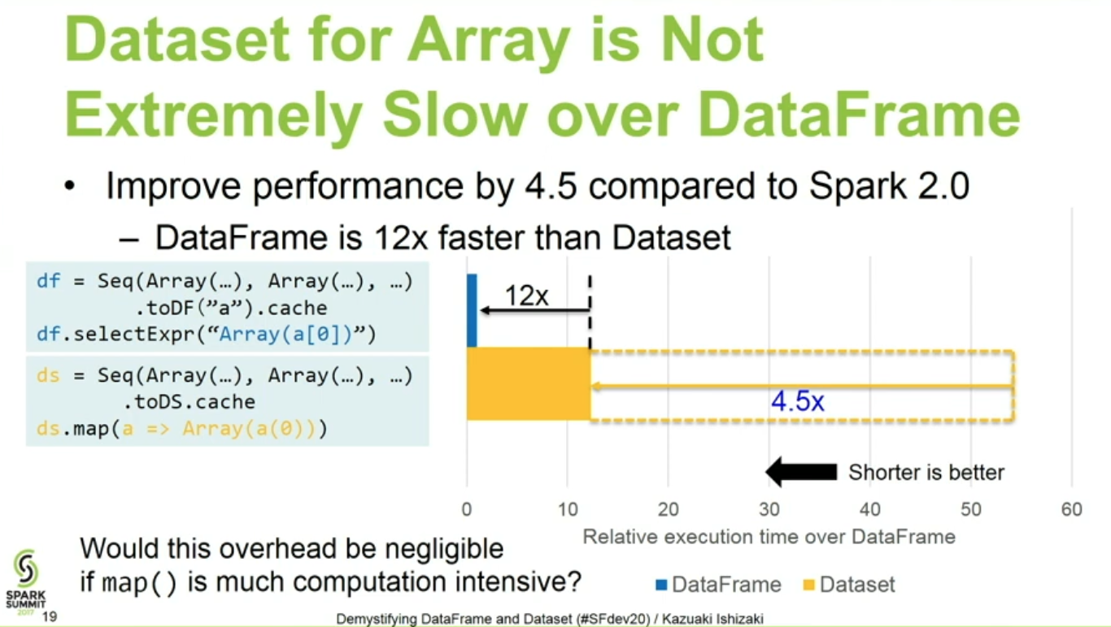
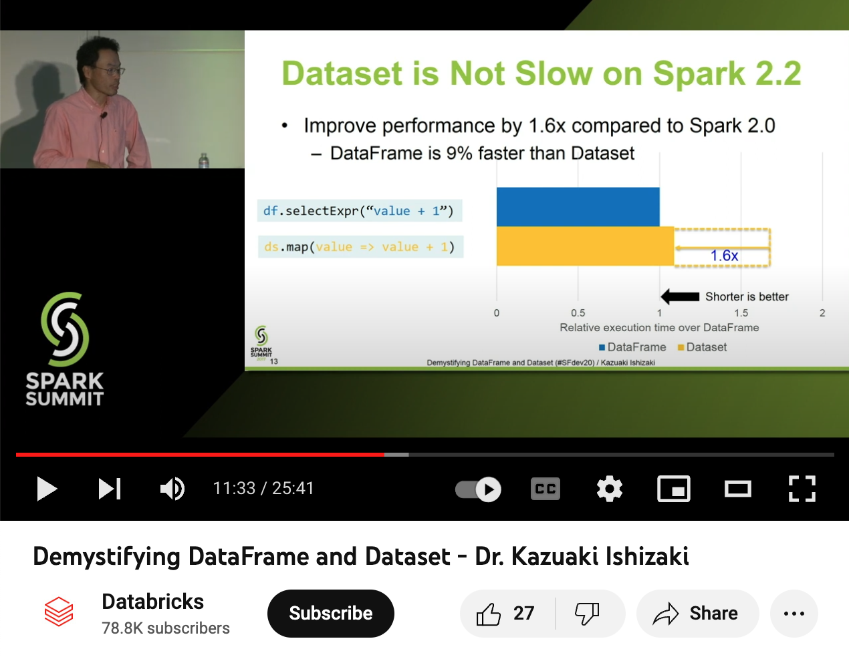
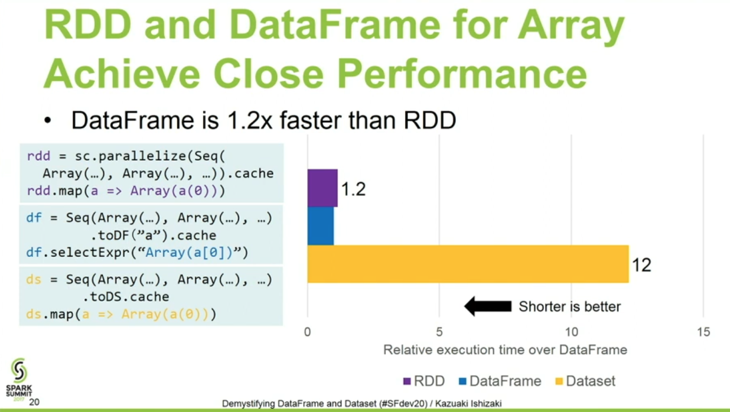
Are datasets slower than DF?
Some benchmarks still find DS slower and more buggy
Recommended session:
Images and Video source: https://youtu.be/AIxtaroWqBU

Slide 8
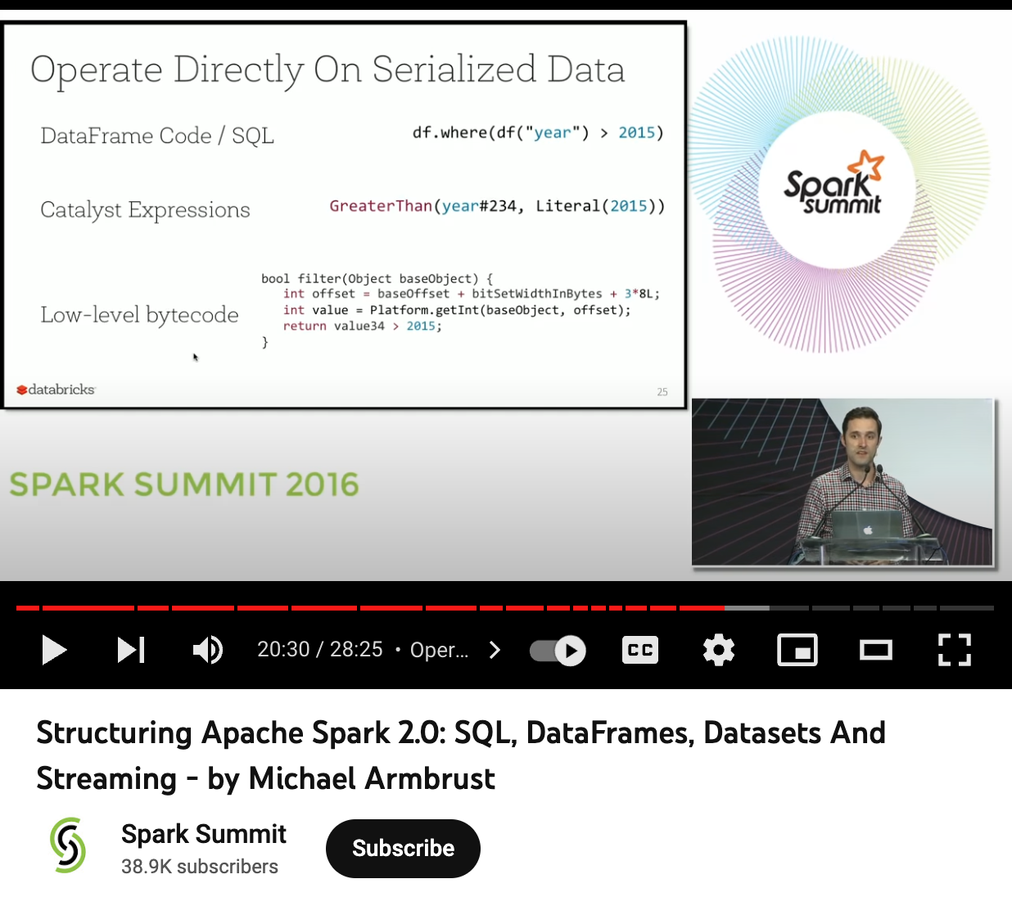
My recommendation, but look for other opinions or sources;
i.e. Spark committers, Spark Summits, Research Papers, official benchmarks, …
Recommended session:
Stick to Spark Dataframes (at least for now)
Simplification + Performance
Source: https://youtu.be/1a4pgYzeFwE

Slide 9
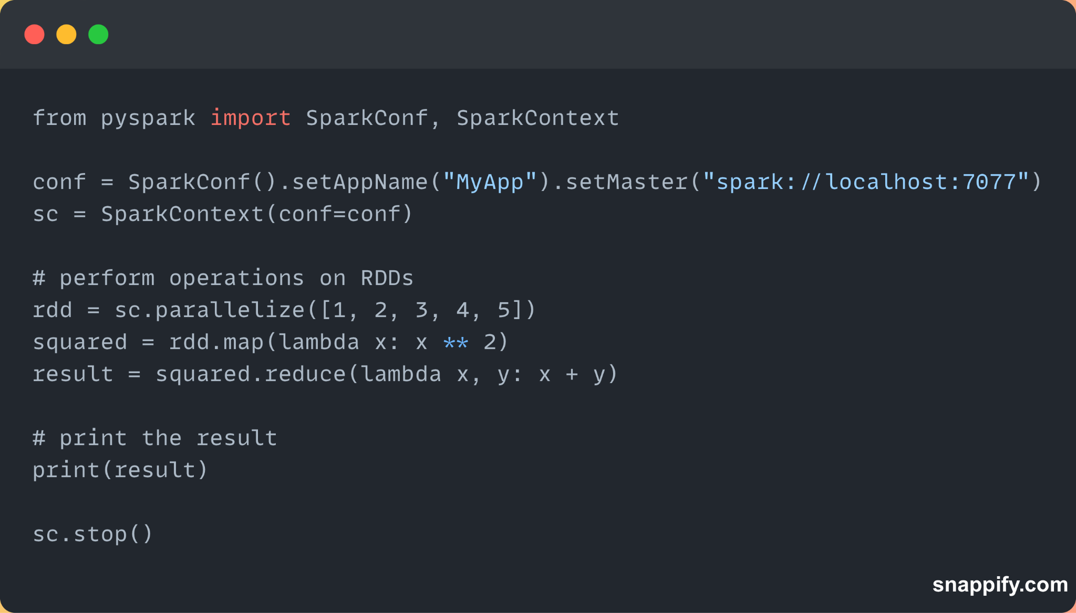
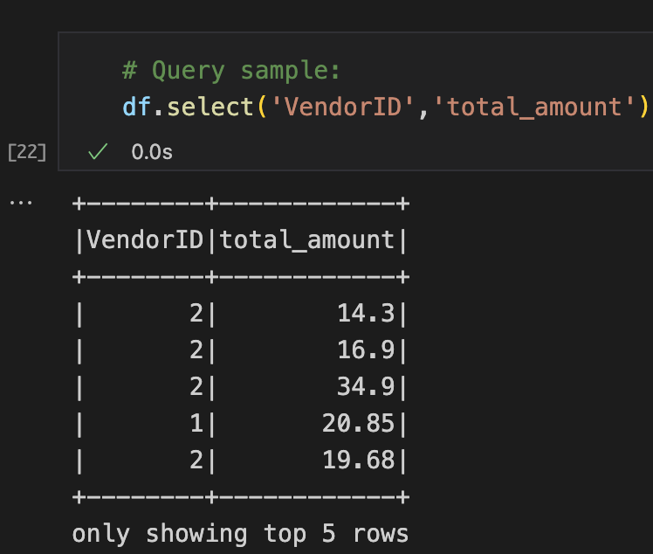
When to use what: RDD, Dataframes, Datasets
RDD are better for low-level:
Unstructured data
No schema validation
DataFrames & Datasets are better for:
Semi-structured data
Schema validation
Including Dynamic schema or schema evolution.
Coming up: Spark context vs. Session
*RDD = resilient distributed dataset (more to come!)

Slide 10
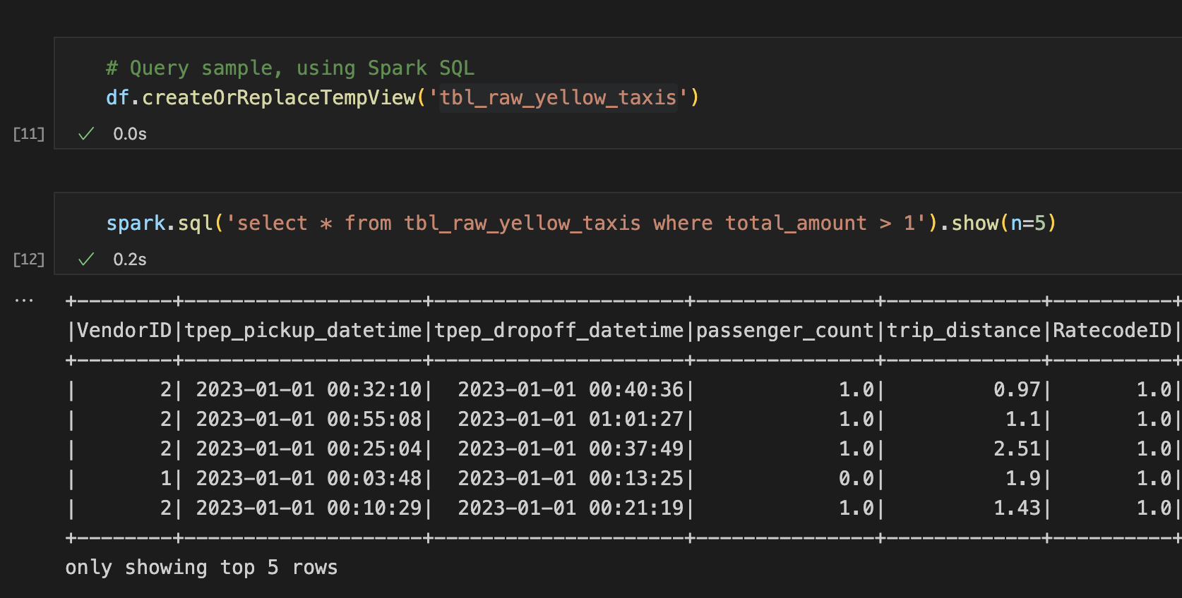
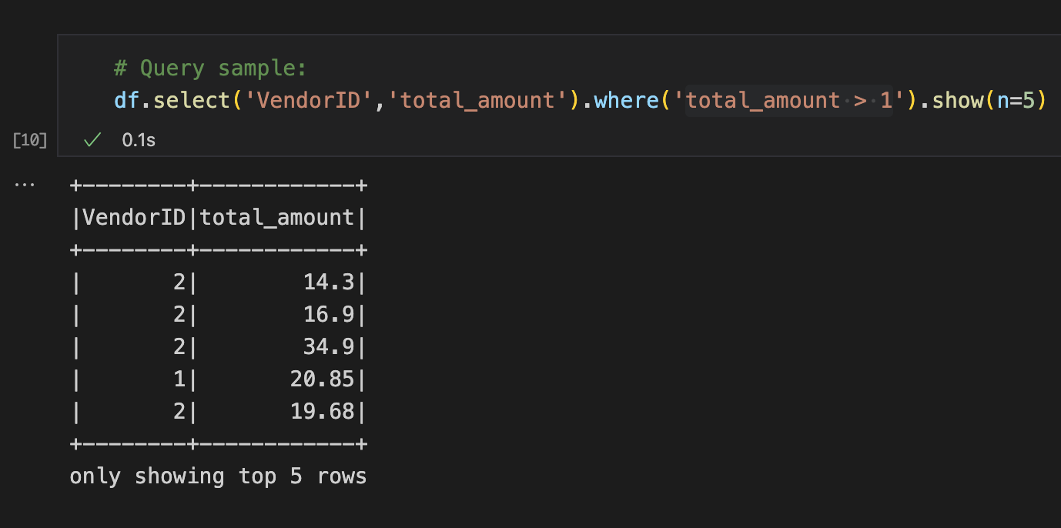
Spark SQL
Same execution engine is used
Developers can easily switch back and forth between different APIs
i.e. which provides the most natural way to express a given transformation.

Slide 11

Next…

